Slide 1
Song Popularity on Spotify
Rohit Gadiraju

Slide 2
Problem Statement
What song attributes, words used in titles, & artists contribute the most to a song being more popular?
How accurately can these attributes predict the popularity of songs not yet released?

Slide 3
Potential Outcomes of Analysis
Providing insights to allow
Artists & bands to create more popular songs
Recording labels & music producers to develop & release more popular music
More popularity usually means more financial success

Slide 4
Description of Dataset
Obtained from Kaggle but originally extracted from Spotify’s API
603 rows with 14 attributes each
All values for numeric attributes assigned by Spotify’s scoring system
Attributes:
Title
Artist
Genre
Year (all songs from 2010-2019 but year will not be used in analysis)
Beats Per Minute
Energy (how energetic song is)
Danceability
Loudness
Liveness (how likely song is a live recording)
Valence (how positive the mood of song is)
Duration
Acousticness
Speechiness (how much spoken word song contains)
Popularity

Slide 5
Data Wrangling
No missing data
Many ‘outliers’ but still acceptable values
Rows removed due to
Having value of 0 for all numeric attributes (1 row)
Multiple rows for same song but different year (14 rows)
Multiple rows for same song but different popularity scores (2 rows)

Slide 6
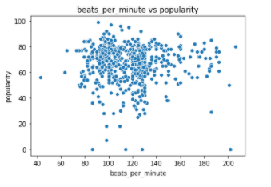
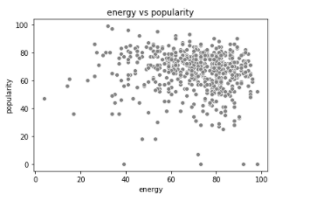
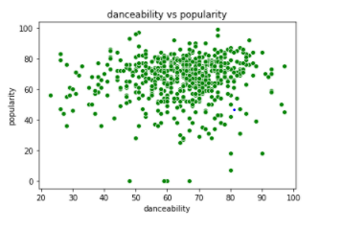
EDA: Scatterplots

Slide 7
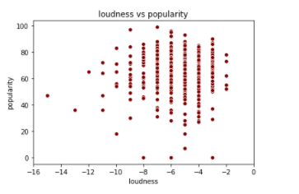
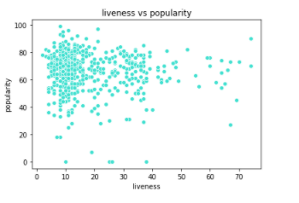
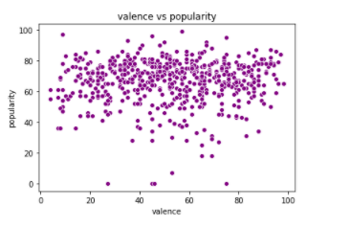
EDA: Scatterplots

Slide 8
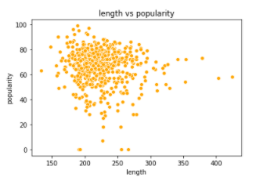
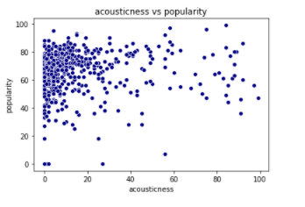
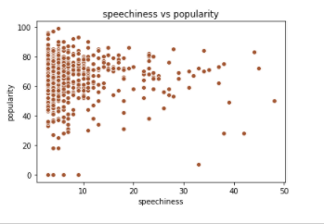
EDA: Scatterplots

Slide 9
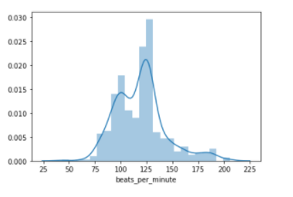
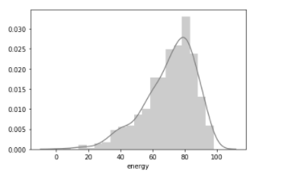
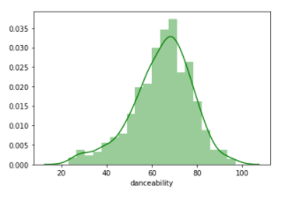
EDA: Histograms

Slide 10
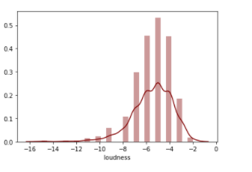
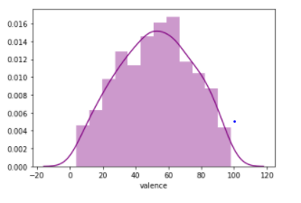
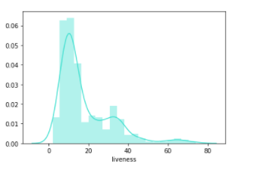
EDA: Histograms

Slide 11
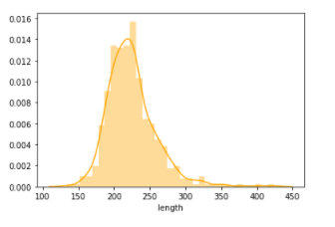
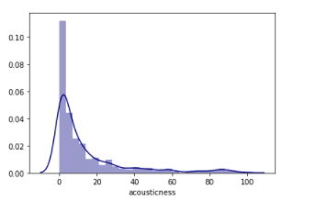
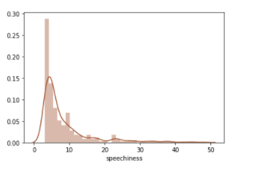
EDA: Histograms

Slide 12
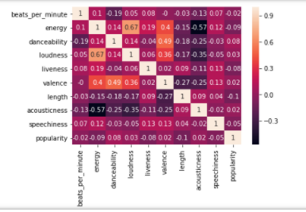
EDA: Correlation Matrix

Slide 13
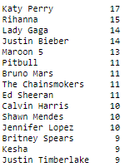
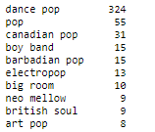
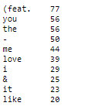
EDA: Artist, Genre, & Song Words Frequency

Slide 14
EDA Summary
No correlation seen between numeric attributes & popularity individually
Two pairs of attributes were correlated
Energy & Acousticness (-0.57)
Energy & Loudness (0.67)
Highly disproportionate number of songs belong to or are associated with the pop genre
Genre will not be used as an attribute in analysis due to this

Slide 15
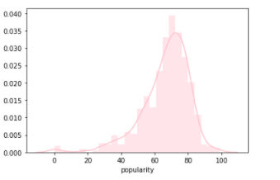
Popularity Statistical Analysis
Range from 0-99
518 songs had a popularity score above 50
269 songs had a popularity score above 70
166 songs had a popularity score above 75
Mean of 66.5 & standard deviation of 14.4
95% confidence interval of mean: 65.4 - 67.7

Slide 16
Machine Learning: Linear Regression
‘Best’ linear regression model included significant numeric attributes, words used in titles, & artist names
Only words that appeared at least 5 times but not in more than 70% of song titles were used
Only artist names that appeared at least 3 times were used
Explained about 20% of the variation in popularity scores
Had an RMSE value close to 15
Regression with only numeric attributes had an RMSE value of 13 but only explained 4% of the variation in popularity scores

Slide 17
Machine Learning: Linear Regression
Significant numeric attributes:
Energy (-0.20)
Danceability (0.16)
Loudness (1.44)
Significant words in titles:
Be (-11.07)
Good (9.94)
Lose (12.05)
one (-13.24)
Your (-11.97)

Slide 18
Machine Learning: Linear Regression
Significant artist names:
Bieber (4.51)
Clarkson (36.17)
Grande (9.17)
Harris (14.07)
Jennifer (-57.27)
Kelly (-38.32)
Lewis (6.52)
Lopez (47.32)
Maroon (7.62)
Martin (-16.42)
Mendes (10.83)
Minaj (-24.19)
Smith (23.28)
Spears (-12.02)
Stefani (-23.56)
Timberlake (-11.00)

Slide 19
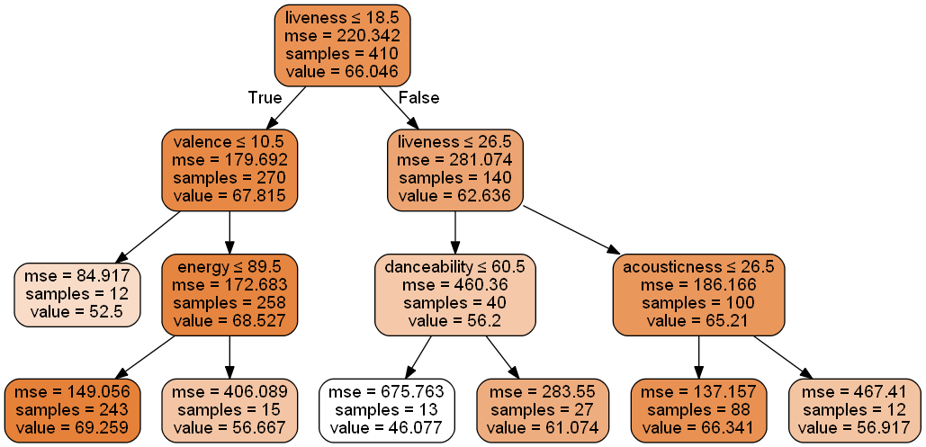
Machine Learning: Decision Tree, Random Forest, Gradient Boosting, & kNN
Decision tree, random forest, gradient boosting & kNN regression models also run using only numeric attributes
All models had RMSE value below 15
Decision Tree – 14.46
Random Forest – 13.17
Gradient Boosting – 14.29
kNN – 13.41

Slide 20
Conclusions
20% of variance in popularity score being explained is not high % but popularity depends on human preferences which are difficult to predict
Results skewed by specific songs present within dataset
Only 586 out of millions of songs available on Spotify considered
Models unable to have higher predictive power due to relatively small sample
Also obtained unexpected (high/low) coefficient values associated with attributes due to sample size
Ex: Only popular or unpopular songs associated with a well-known artist could have been included
Effectiveness & ineffectiveness of certain numeric attributes & words in titles could change as well given additional song data

Slide 21
Conclusions
Numeric attributes were still relatively effective in predicting the popularity of songs within tests sets
Most effective models were able to predict popularity scores within a +/- 13-15 score range
Linear Regression, Decision Tree, Random Forest, Gradient Boosting, & kNN models all had RMSE values within this range
With more data & hyperparameter tuning, error range could be lowered

Slide 22
Future Work
Extract more data from Spotify’s API & re-apply steps & models created on additional data to see if popularity can be predicted more accurately
PCA can be used to reduce & combine additional dimensions
More advanced NLP techniques can be used to extract more meaning from words in titles & which artists are associated with a song
If additional songs are more evenly distributed between different genres, genre can be used as a predictor variable

